Slide 1

Goal: $2,500
Received: $2,500

Slide 2


Church Leadership Council Meeting
October 13th
at 5:30 pm

Slide 3

October 20th
Following Morning Worship

Slide 4

Church Leadership Council Meeting
October 13th
at 5:30 pm
October 20th 12:30 am

Slide 5

3:00 pm
October 27th

Slide 6
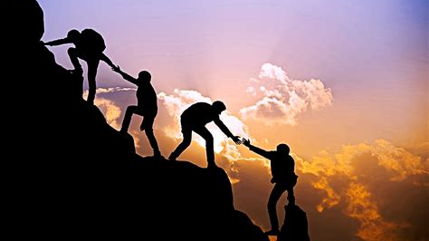
^{October 27th}
^{4:00 pm}
Deacons Meeting

Slide 7



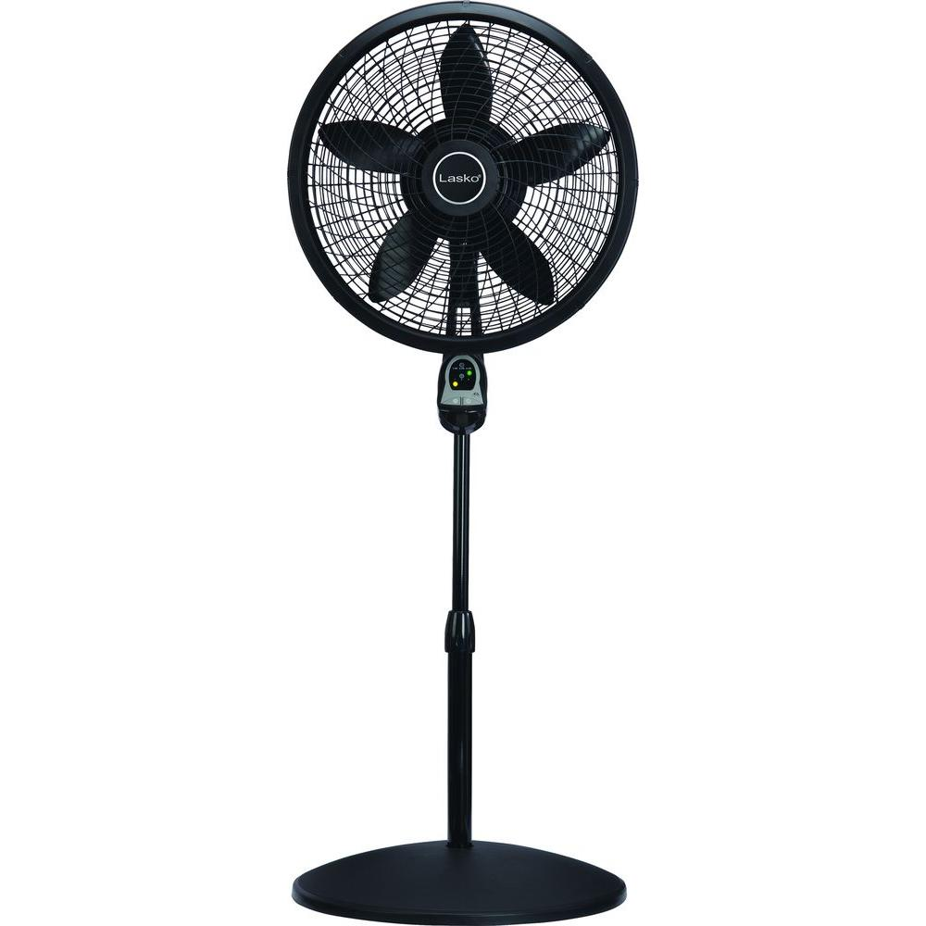
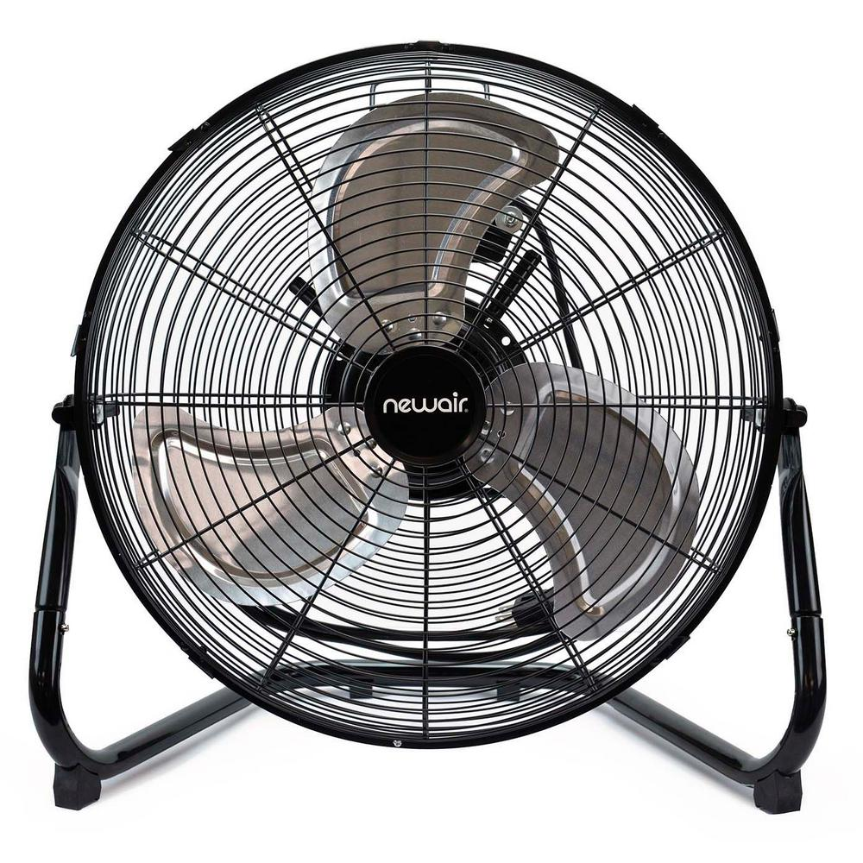


Fans and umbrellas!
October 23rd they will be taken to Mexico to pastors in need.

