Slide 1


Slide 2
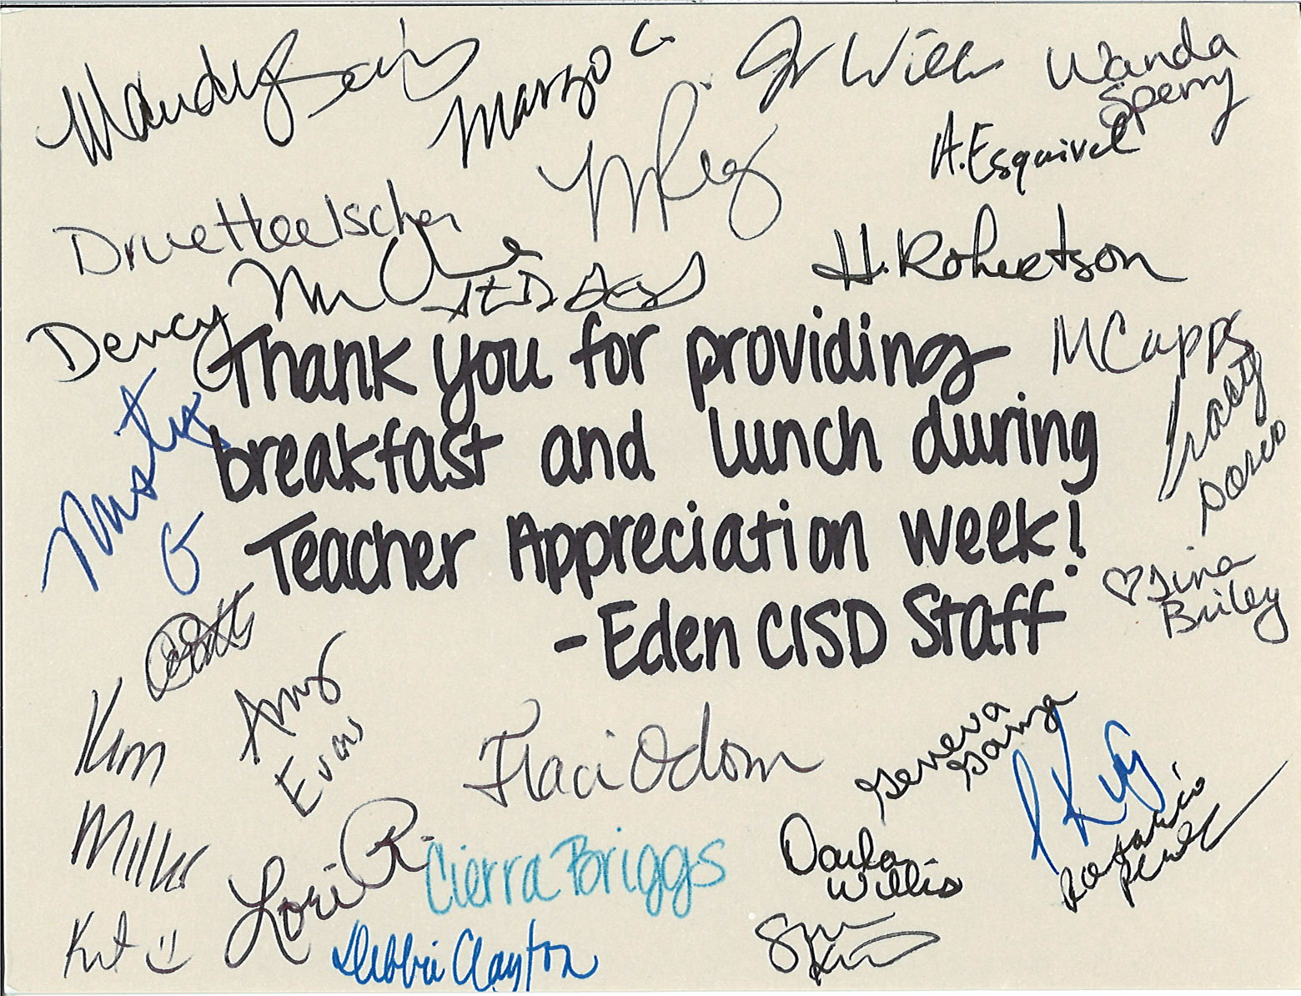

Slide 3

Preteen Camp
June 17-21

Slide 4

3:00 pm
June 27th

Slide 5


Slide 6
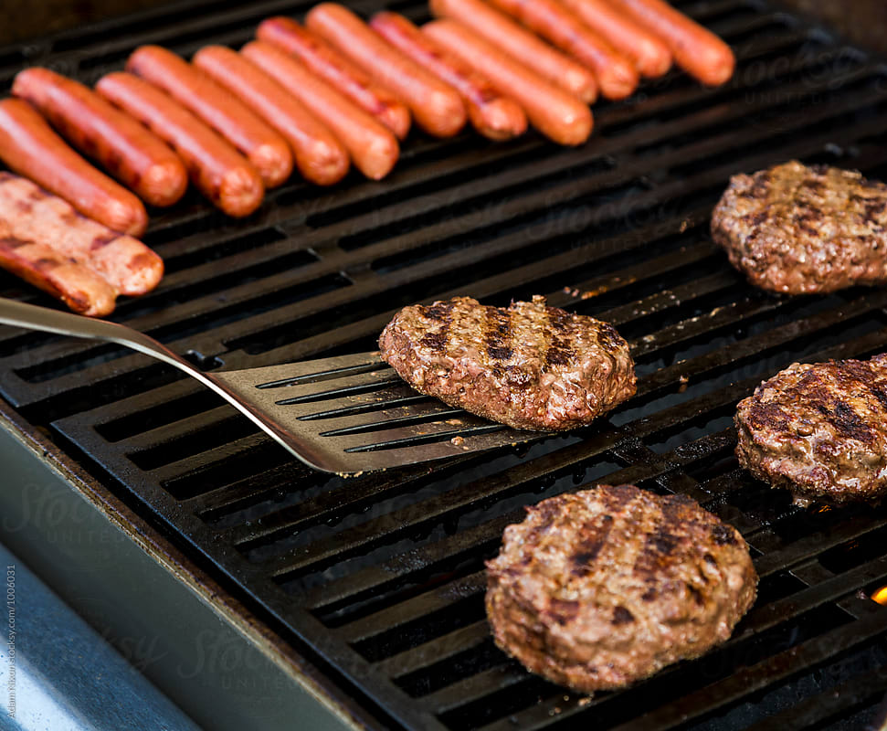

Post-Father’s Day Cookout
June 29th
Hamburgers and Hotdogs provided
^{Bring sides and desserts}
^{Sign up sheets in foyers}

Slide 7
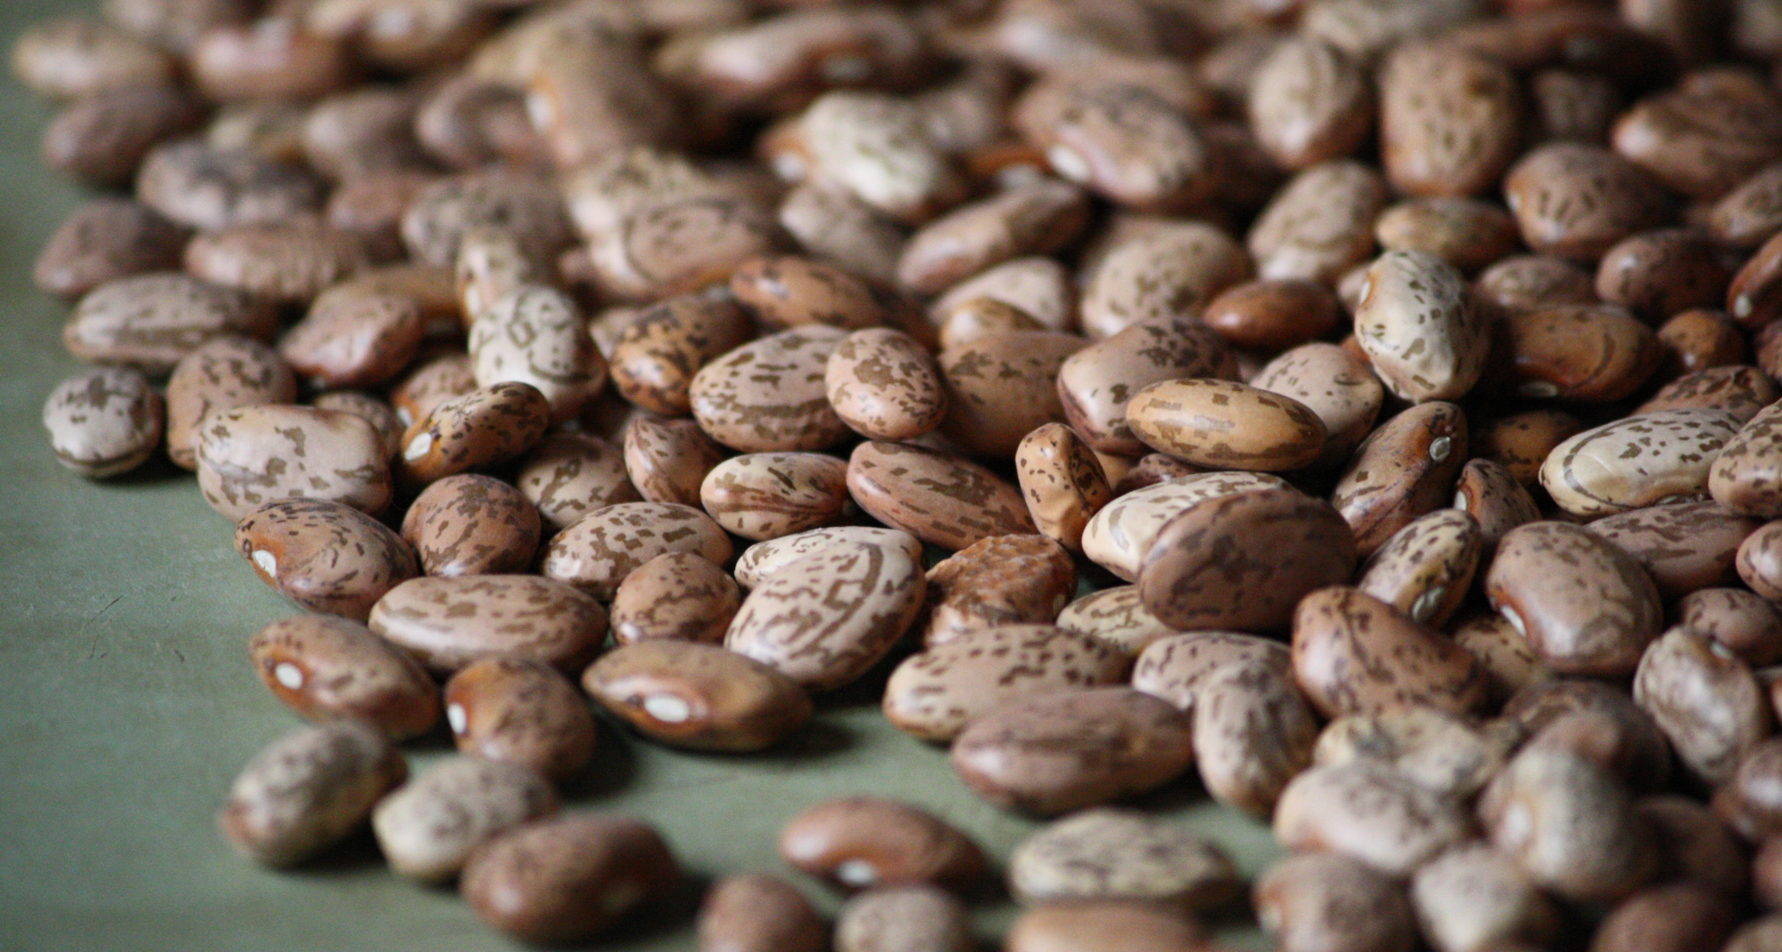

Beans & Rice
50# of Beans & 50# of Rice cost approximately $61.94
Place “Beans & Rice” in the memo field of your check if you want to donate to this effort
We’ll collect through June

